Slide 1
Project Proposal – “Tanks”
Savanah Many Joseph Chouinard Matthew Goldstein

Slide 2
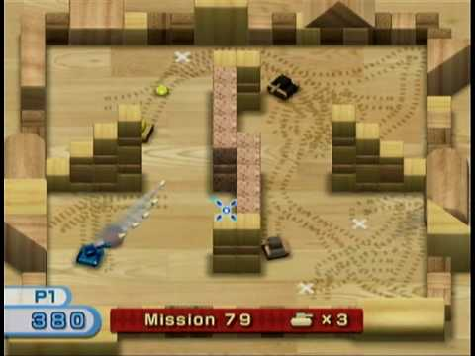
The Game – Tanks
A Windows rendition of the WiiPlay game “Tanks”

Slide 3
Images
Tank base
Tank gun
Wall
Bullet
Floor (tile-able)
Mine
Mouse pointer image

Slide 4
Separate Classes
World
Wall
Bullet
Tank
AI Tank (possible extensions for different types of AI)
Collision (holds functions to test if two objects have collided)
To declutter main class
ReadFile (to generate maps of levels)

Slide 5
Possible Collisions
Bullet with Wall
Bullet with Player
Bullet with AI
Bullet with Mine
AI with Wall
AI with Mine
AI with AI
AI with Player
Player with Wall
Player with Mine

Slide 6
Possible Extra Goals
Bullet collision with other bullets
Multiplayer
Score
More levels
More advanced AI options
Animations

Slide 7
Controls
W – move forward
A – rotate left
S – move backward
D – rotate right
Space – place mine
Move mouse – aim gun
Mouse Left Click – fire gun

Slide 8
Expected Roles
Joe –
World Management / Drawing
Matt –
AI
Collision Detection
Savanah –
Tanks
Bullets
ALL –
Images

Slide 9
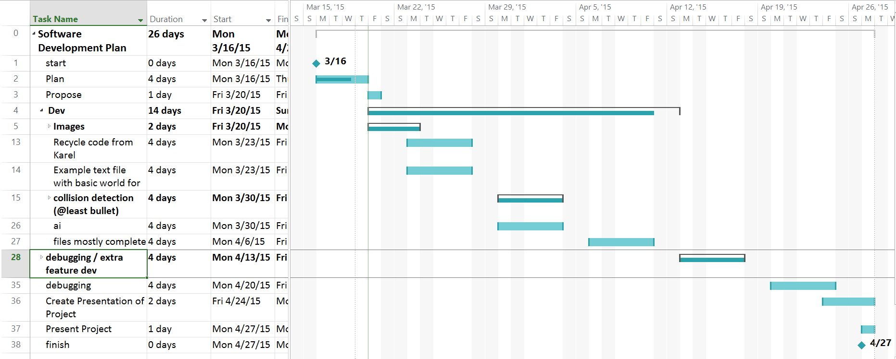
Expected Timeline

